Slide 1
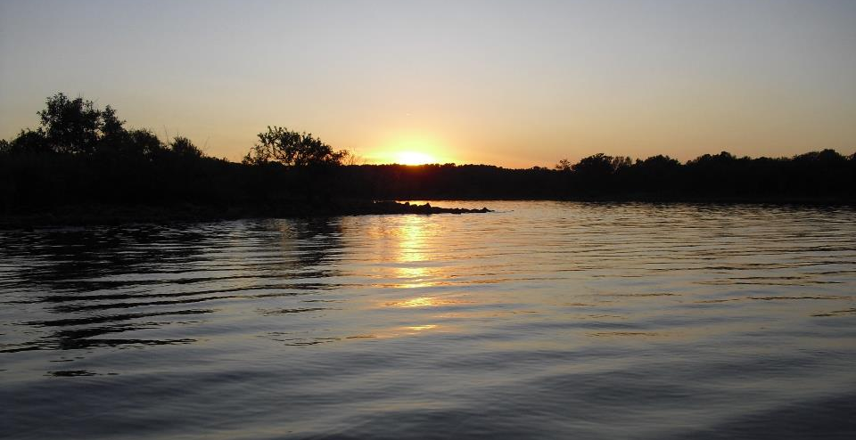
Quality Assurance, QAPPs, DQOs and SOPs
GCSA Workshop
OKR04 MCM-3 and Part IV Sampling and Field Methods
Presented by INCOG
Nienhuis Park
May 18, 2022

Slide 2

Stormwater Program Quality Assurance (QA)
Levels of QA Recommended For Stormwater Programs

Slide 3

QA and QC In Water Quality
Quality Assurance (QA) is a set of procedures and criteria that ensures the environmental data generated is of suitable quality and quantity to meet all water quality monitoring goals.
Quality Control (QC) is the process of verifying or determining the quality of the environmental data generated and the QA procedures used. QC refers to the measurements and tests used to determine if the study results meet the standards established for the study.

Slide 4

QA is a part of everyday life:
  Purchases: safe, effective, ease of use, etc.
  Workplace: resources, benefit/cost, quality, etc.
QA provides reassurance and protection.
QA in water quality is fundamental:
  Data quality and integrity
  Data reliability and usefulness
Pushing QA beyond usefulness is a waste of resources.
Levels of QA: What’s Needed and When To Stop

Slide 5

QA Is Essential To Good Data
Quality Assurance (QA) applies to:
“Monitoring” data (e.g. field and lab data).
Observation data (e.g. visual inspections).
Records of meetings, emails, letters, etc.
Data analysis (e.g. statistics, graphs, tables).
Reports and data transfers (e.g. spreadsheets, letters).
Program Management structure and lines of authority.
Storage, calibration and use of equipment and supplies.

Slide 6
Employee Training In QA Topics
MS4 staff need QA-related training in:
Construction inspections
Dry Weather Field Screens
Source tracking inspections
Appropriate field equipment
Safety of field kit use
Proper use of field kits
Identifying illicit discharges
Rules for property access
Water quality impacts
Developing & using forms
Field safety & dangers
Confined space entry
Dealing with chemical exposure
How to conduct interviews
MS4 documents & credentials
Processing lab samples
Chemical spill procedures
Management requirements

Slide 7
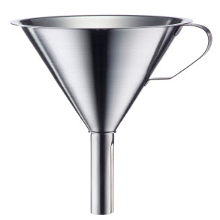
Effective Data Management
DATA IN-FLOWS
DATA OUT-FLOWS
Information to Media
Lab & Field Data
Data for Court
Who, what, where, when, why, how
Enforcement Data
Measurable Goals
Visual Observations
Reports to Councils
Data Management System
Management Reports
Photographs
Reports to City Staff
BMP Quantities
Inspection Interviews
Reports to Citizens
Map Data
Data to Agencies
Data from Agencies
Training Records
DEQ Annual Report
Program Audits
Complaint Tracking
Budget items

Slide 8
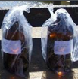
Who Uses Formal QA in Water Quality
Every EPA-funded water quality study must have formal QA.
Not just for sampling; QA is also required for data analysis, GIS, modeling and other ancillary water quality work.
TMDLs: All monitoring must use formal QA.
In Oklahoma, state and federal agencies are experts in QA:
  State: INCOG, ACOG, OCC, OWRB, DEQ, ODWC, Corp. Comm.
  Federal: FWS, COE, USGS, etc.

Slide 9

QA Considerations In Data Use
“Comparability” of different data sets.
Quality of data (testing, age, sites, sampling, conditions, etc.).
“Representativeness” of data to project goals.
Visualization tools (graphs, tables, pictures, etc.).
Statistics and data interpretation (e.g., “Trend Analysis”).
Narrative descriptions of sites and findings.
Errors and mis-statements: data correctness and generalizations.
Problem resolution: data that shows no trends, systemic errors.
Contradictory data: when to reject data and re-sample.

Slide 10
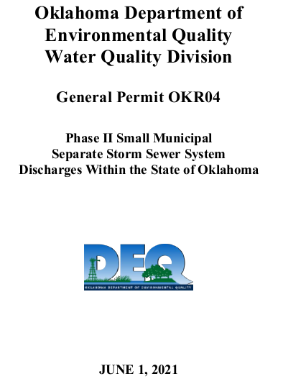
QA References in OKR04
OKR04 Part VII.J (only 1 reference to “QA” in OKR04): “…Proper operation and maintenance also includes adequate laboratory controls and appropriate quality assurance procedures.”
OKR04 Part VI (Monitoring, Record Keeping and Reporting):
  “Samples and measurements...shall be representative...”
  “Laboratory methods require analysis… conducted according to test procedures approved under 40 CFR Part 136.1 et seq.”
  “Monitoring records must provide...[dates, names, times, place, methods, results, etc.]”
  “Reporting of all monitoring results may be required… to be submitted electronically…”
  Must retain records of all monitoring activities at least 3 years.

Slide 11
“Representativeness” in OKR04
Only 1 passage in OKR04 refers to representativeness: Part VI.A.2 under “Monitoring, Record Keeping and Reporting”:
“If you plan to conduct monitoring, you are required to comply with the following methods: a. Representative monitoring requires that samples and measurements taken for the purpose of monitoring shall be representative of the monitored activity.”
Defining “Representative” and “Representative Monitoring”:
  OKR04 permit: (does not define)
  EPA QA Guidance: many detailed concepts to support data quality.
  Oklahoma WQS: general use of term, such as “a single monitoring site shall be considered representative of no more than 10 stream miles for wadable streams.”

Slide 12
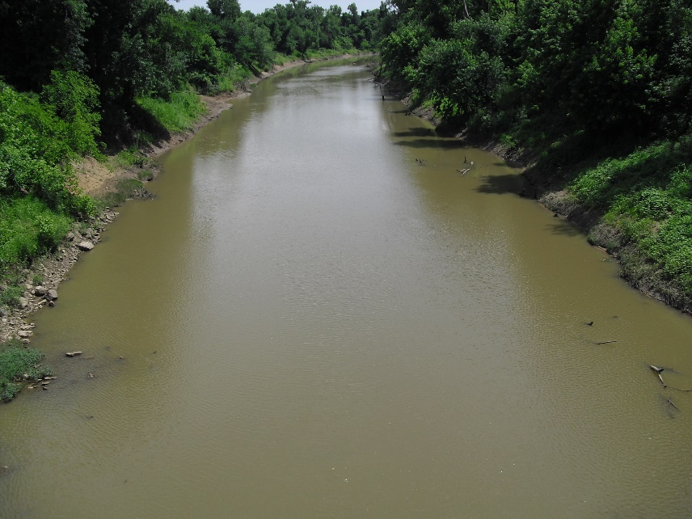

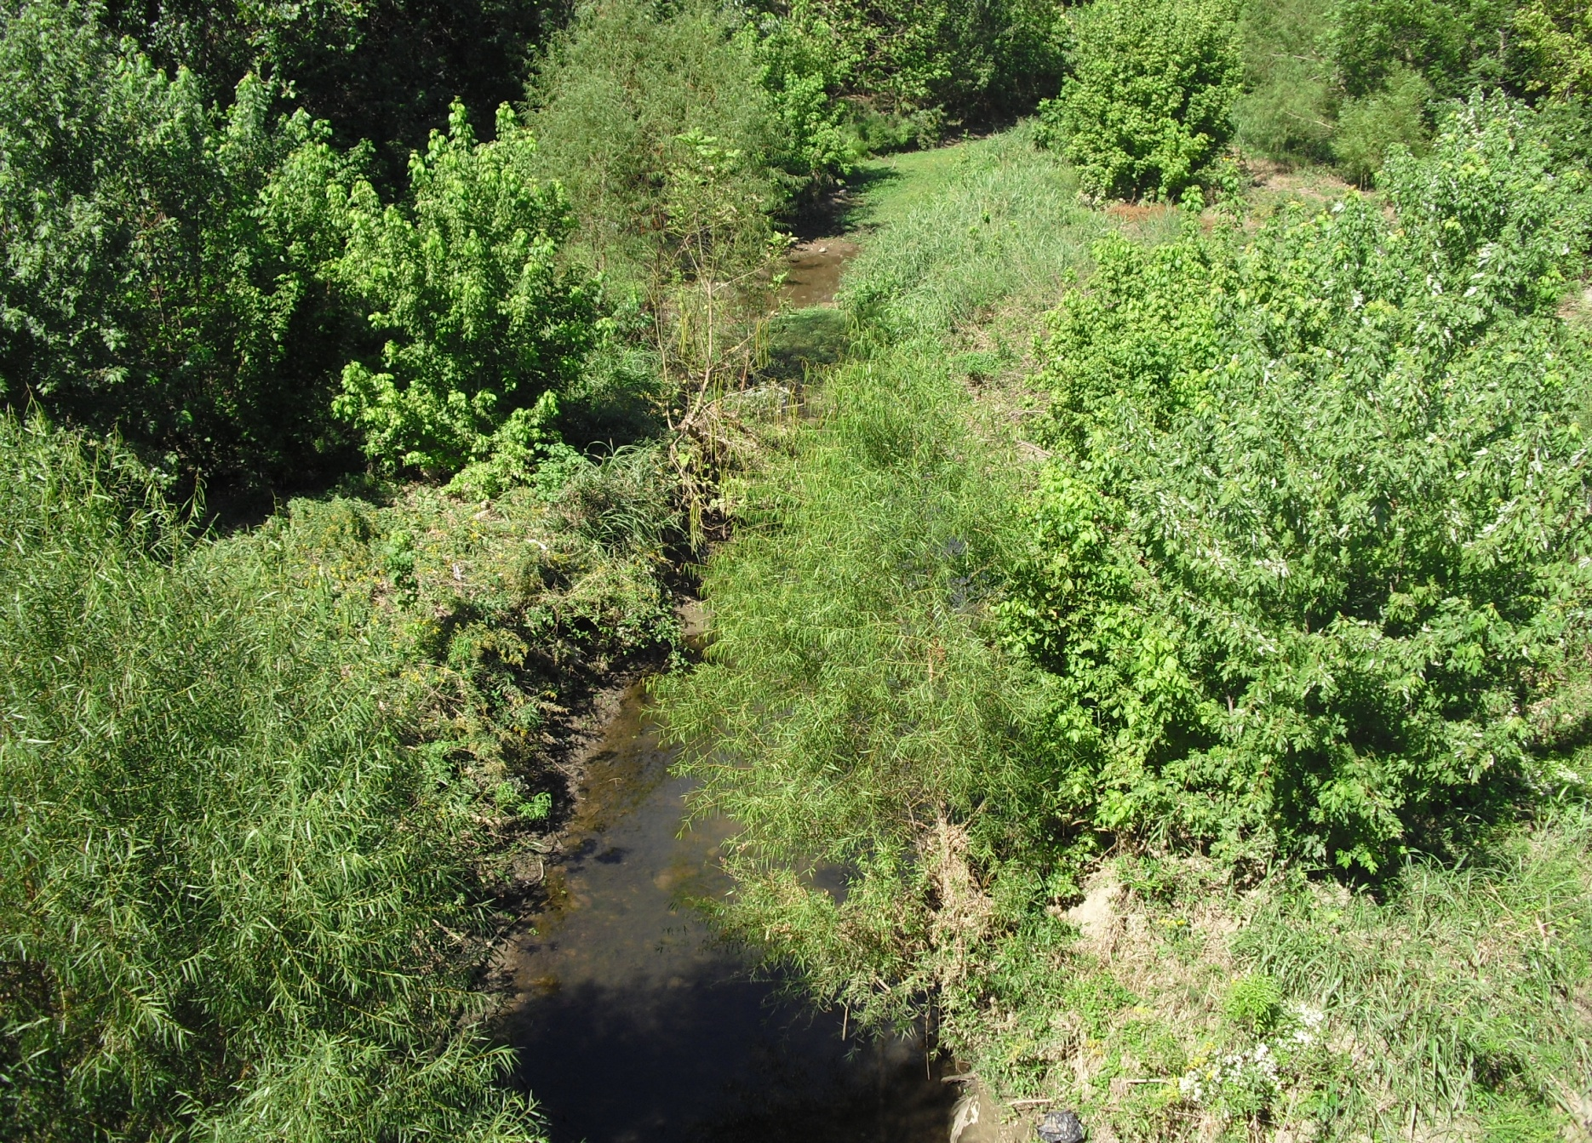
QA Representative Considerations
Not just 303(d)’s 1 site representing 10 miles of a wadable stream or 25 miles of a non-wadable stream.
What are your sampling goals (DQOs) ?
Account for site conditions: shading, time of day, season, runoff, stream bed, land uses, stream “order” and hydraulics.
Types of streams: pools, riffles, runs…
Intermittent / ephemeral: are pools disconnected (dry stream bed)?
External sources: NPDES dischargers, wildlife, septic tanks, industries, dumping…

Slide 13
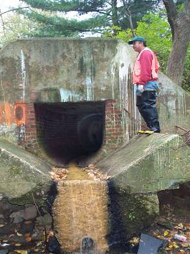
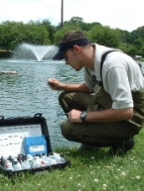
OKR04 Activities Needing Formal QA
Technically, all activities pertaining to any type of data collection, analysis, storage, transfer and reporting....
  303(d) POC source inspections
  DWFS monitoring of MS4 (MCM-3)
  Source tracking inspections (MCM-3)
  Illicit discharge enforcement (MCM-3)
  TMDL POC monitoring and compliance
If private consultants and/or labs are used, be sure that they employ appropriate and adequate QA to their activities.
Make this part of your contract specifications, especially if their work is needed for enforcement or court evidence.

Slide 14

Most Important OKR04 Program QA Documents
QAPPs – QA Project Plans – procedures for data gathering, analysis and reporting (informal for OKR04; formal for TMDLs)
DQOs – Data Quality Objectives – selecting the types of data to be collected and how data will be used (informal DQO process for OKR04, more formal for QAPPs)
SOPs – Standard Operating Procedures – detailed instructions for performing each data collection activity, including use, storage and care of measurement equipment (recommended for many OKR04 tasks)

Slide 15
Terms: Precision and Accuracy
Precision is a measure of how close multiple readings are to each other in the same sample.
Accuracy is a measure of how close a reading is to the known (accepted to be true) value.
Both are important concepts in assessing quality of data.
Both are normally reported with laboratory data.

Slide 16
Terms: Important QA Concepts
Representativeness
Does the sample represent what you intend?
Do you have enough samples and measurements?
Completeness
Can your data be used with other data sets and by other programs?
Comparability
Legal documentation of “ownership” of samples during all phases of transport.
Chain of Custody
Information on each sample bottle to show ownership, collection information and intended analyses.
Sample Labels

Slide 17

EPA’s QA Guidance Documents
  https://www.epa.gov/quality/quality-assurance-planning-region-6
  DQO Guidance: QA/G-4
  QAPP Guidance: QA/R-5 and G-5
  QMP Guidance: QA/R-2
  SOP Guidance: QA/G-6
QAPPs are not approvable by EPA unless they pertain to projects funded by EPA, such as water quality grants.
QMPs (Quality Management Plans) only apply to EPA-funded projects.
EPA periodically offers QA training courses.

Slide 18
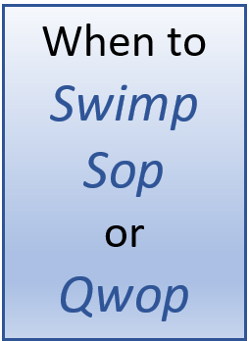
QA Requires All Three
SWMPs are required by OKR04:
  Simplest procedures, free styles
  Can reference (defer to) SOPs
  Must review and update annually
SOPs provide more details:
  Not required by OKR04, but allowed
  Greater skill and technical details
  Can be bound together as one document
QAPPs only required by OKR04 for TMDL monitoring:
  Greatest technical difficulty, most beneficial
  Comprehensive; ties together all program actions

Slide 19
Quality Assurance Project Plans (QAPPs)
The highest level of QA Documentation

Slide 20
EPA QAPP Guidance and Contents
EPA’s QA/G-5 provides QAPP guidance (has 24 QAPP “elements”).
EPA’s QA/R-5 provides QAPP requirements (content overview).
QAPPs include Data Quality Objectives (DQOs) for the project.
QAPPs have 4 “Groups”, and each Group has sub-parts:
  Group A: Project Management (organization, tasks, DQOs)
  Group B: Data Generation and Acquisition (methods)
  Group C: Assessment and Oversight (administration)
  Group D: Data Validation and Usability (meeting DQOs)
“New” QAPPs can be modified from other QAPPs as templates.
Solicit “peer review” from others with QAPP experience.

Slide 21
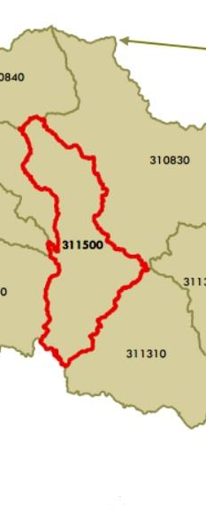
TMDL QAPP Requirements
  Part IV.B has many TMDL QA and monitoring requirements.
  Each TMDL Report has its own QA and monitoring requirements.
Both OKR04 and TMDL Reports require MS4s to perform monitoring under a QAPP that complies with EPA QA/R-5.
No present DEQ guidance or procedures for writing QAPPs.
DEQ had been planning to prepare QAPP guidance for TMDL monitoring with GCSA help.
There will be GCSA support for preparing QAPPs.

Slide 22
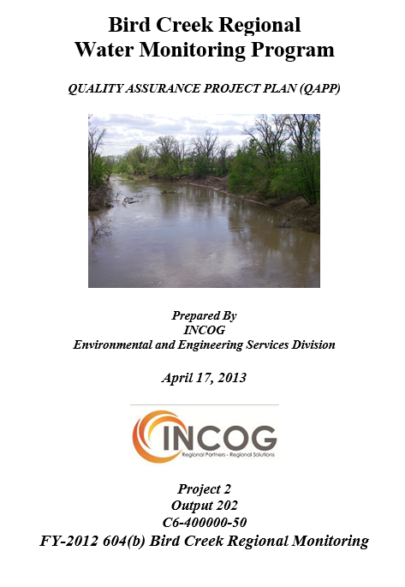
Preparing Your First QAPP
QAPP Contents are very complex and formal:
  Difficult EPA QA/R-5 and QA/G-5 requirements
  Fully detailed sample collection & test methods
  Fully detailed data analysis and reporting
  Details of DQOs, participants and management
  You must understand all technical requirements
QAPP Templates? Yes, but… use a recent QAPP.
QAPP Approvals? None… DEQ may review…?
QAPP Help? Uncertain for non-GCSA… DEQ…?
GCSA QAPP Guidance? Planned… format, depth?
QAPPs for entire MS4 Program? not required, but…
Example

Slide 23
TMDL QAPP Due Dates
TMDL QAPP due date depends on if the Optional Baseline Monitoring Plan (BMP) is used or not.
If Optional BMP:
  BMP QAPP due 5/31/2025
  TMDL MP QAPP due 5/30/2030
If no Optional BMP:
  TMDL MP QAPP due 5/31/2025
OKR04 requires an EPA-based QAPP to be prepared for both BMPs and MPs.
Can an MS4 prepare a single QAPP to cover both the BMP and MP?
  Depends upon DEQ’s TMDL monitoring strategy and how the BMP and MP monitoring programs overlap.
Example

Slide 24
Data Quality Objectives (DQOs)
Deciding Data Uses In Advance

Slide 25
Data Quality Objectives (DQOs)
Essential QA program elements, starting with:
  DQOs – how data will be used and by whom.
  SOPs – detailed methods for a single task.
  QAPPs – all project methods tied to goals.
DQOs are part of a QAPP document.
Always start a QA program with defining DQOs.
Even informal QA must include at least a simple DQO process.
DQOs are least understood and used, but are the most important.
DQOs demand pre-planning and full understanding of goals.
SOPs
QAPPs
DQOs

Slide 26
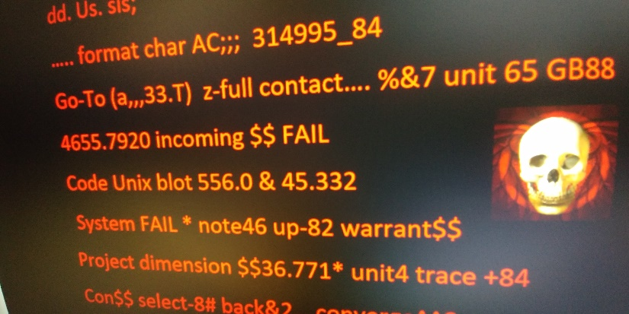
DQO Process in EPA QA/G-4 Guidance
G-4 is 121 pages long, and very technically difficult to use.
Seven steps in EPA’s formal G-4 DQO Process:
  State the problem
  Identify the goals of the study
  Identify information inputs
  Identify the boundaries of the study
  Develop the analytical approach
  Specify performance or acceptance criteria
  Develop the plan for obtaining the data
Formal G-5 QAPPs require use of the formal DQO process.
Is there a simpler DQO and QAPP process for OKR04?

Slide 27

Simpler DQO Steps for OKR04
Simpler (informal) DQO steps:
  Define project goals and purpose of study
  Identify how data will be used and by whom
  Define project boundaries (area, time-frame, budget, etc.)
  Identify all data sources (existing and to be collected)
  Describe data collection methods
  Describe how data will be analyzed and reported
These essentially meet the EPA G-4 steps, but are more common sense.
More informal data projects can have a more flexible DQO process.
Ultimately, DQOs are logical steps to help your project succeed.

Slide 28
Data Interpretation
Each chemical (“analyte”, “parameter”, etc.) is unique.
Many have limits in the Oklahoma WQS; some do not.
OKR04 does not require the MS4 to confirm violations of WQS.
No pollutants are allowed in stormwater runoff, period.
Some tests measure the effects of chemical pollutants (pH, conductivity, BOD, DO, TDS, TSS, turbidity).
Some chemical tests measure different “forms”, (e.g., nitrogen as NO₃⁻ NO₂⁻ NH₃ NH₄⁺ TN TKN ORN)

Slide 29
DQOs: How Will Your Data Be Used ?
Permitting Authority – Annual Reports, DMRs, program audits, compliance & enforcement).
State and Federal Agencies – agencies need local data for WQ projects and investigations.
City Councils & County Commissions – program updates, budgets, justify additional resources or changes to ordinances, etc.
Internal Staff Requests – information flow within city.
Citizens / Local Parties – public education, local WQ concerns.
Local Enforcement Actions – building your case.
Local Media – radio, newspaper, television.

Slide 30
Standard Operating Procedures (SOPs)
Consistency In Routine Task Details

Slide 31
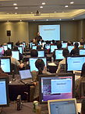
Benefits of SOPs
SWMP “procedures” are mostly short checklists of tasks.
SWMPs have few, if any, QA details or requirements.
SWMP lists of actions are not helpful for staff training.
SOPs have detailed step-by-step procedures for everything that must be done, in sequence.
SOPs include QA and maintenance requirements.
SOP updates ensure that each task has the latest procedures.
SOPs are good education and training tools.
SOPs minimize errors in performing repetitive tasks.

Slide 32
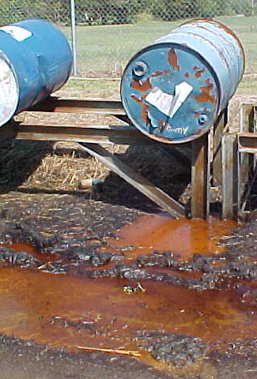
OKR04 Tasks Enhanced By SOPs
Inspections (construction, DWFS, source-tracking, LID, MS4)
Staff Training (handouts of procedures)
Receiving pollution reports (from citizens, staff, agencies)
Spill cleanup (methods, contacts, contracts, safety, PRP)
Proper storage (equipment, vehicles, materials)
Waste disposal (methods, contacts, contracts, safety, PRP)
Monitoring (routine, 303(d), TMDLs, priority areas)
Reports (data handling and analysis, formats, PRP)

Slide 33

If SOPs Are Not Used
OKR04 itself has few detailed procedures.
OKR04 was written broadly to give MS4s flexibility.
OKR04 has many tasks that require detailed steps.
Without SOPs:
  MS4s have no record of their program’s detailed procedures.
  New PMs will not know how to implement many tasks.
  There is no consistency of BMP implementation over time.
  Employee training will be limited without written procedures.

Slide 34

Are SWMP Passages Enough?
SWMP Template: (pertains to counties)
MCM-4 Procedures for Seeking DEQ Construction Enforcement:
The City of P2City will therefore implement the following procedures for taking enforcement action against construction site operators in cooperation with DEQ:
Within 24 hours of finding a construction site sediment or erosion or other waste control problem that requires DEQ assistance as a potential violation, the City of P2City will contact DEQ Enforcement Division by telephone and/or email.
Data and information requested by DEQ will be collected and promptly submitted to DEQ.
Assist DEQ with site visits and/or construction site inspections upon request.
Assist DEQ with administrative tasks needed by DEQ upon request, including arranging meetings and processing reports.
Document all actions taken by DEQ and county staff for each incident, and report all incidents in the City of P2City’s Annual Report.

Slide 35
SOPs For Simple Field Test Kits
Expired chemicals – process for ordering chemicals; log of chemical purchases.
Calibration – log of calibration activities and problem resolution, detailed directions for each kit.
Check samples of known analytes (accuracy test) – log of sample analysis and problem resolution, detailed directions for each kit.
Storage – instructions for equipment and supplies.
Maintenance – log of equipment problems, consistent detailed maintenance records.
Training – establish minimum requirements, log of training (topics, dates, staff).

Slide 36
Field Form SOPs: Visual Observation Consistency
Water velocity (estimated)
Width and depth of water
Color of water
Color of stream bank stains
Odors of the water
Odors within the vicinity
Algae growth
Vegetation (dead or dying)
Trash and debris
Dead animals
Lawn clippings (yard materials)
Barrels and containers
Oily sheen on water
Silt & sediment buildup
Opacity of water
Foam or suds
Chemical residues on banks
Land uses in vicinity
Buildings in vicinity
Interviews with neighbors

Slide 37



Questions ?
Vernon Seaman
Manager, Envir. And Energy Planning
INCOG
Two West 2nd Street, Ste 800
Tulsa, OK 74103
(918) 579-9451
vseaman@incog.org

